Slide 1



Hands-on
Francisco Muñoz-Martinez
francisco.munoz2@um.es
Universidad de Murcia (UM)

Slide 2
Agenda
Time (PT) | Topic | Presenter
1:40 – 2:00 | Flexible Accelerators | José L. Abellán
2:00 – 2:20 | Cycle accurate simulation and Overview of STONNE | José L. Abellán
2:20 – 3:20 | (Hands-on) STONNE | Francisco Muñoz-Martínez
3:20 – 3:40 | Coffee Break
3:40 – 4:10 | (Hands-on) SST-STONNE | Francisco Muñoz-Martínez
4:10 – 4:40 | (Hands-on) OMEGA | Raveesh Garg
4:40 – 5:00 | Roadmap and Concluding Remarks | Tushar Krishna
https://stonne-simulator.github.io/ASPLOSTUT.html

Slide 3
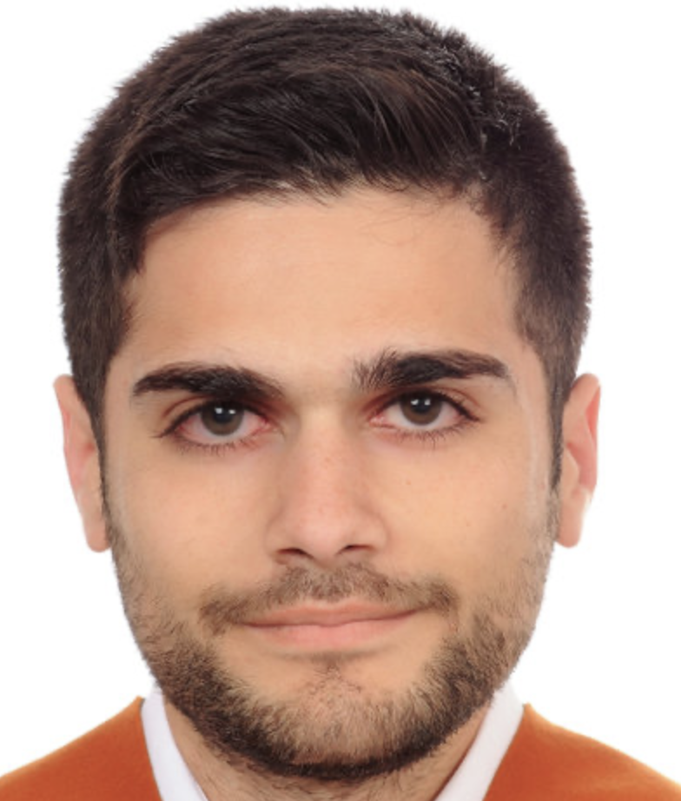

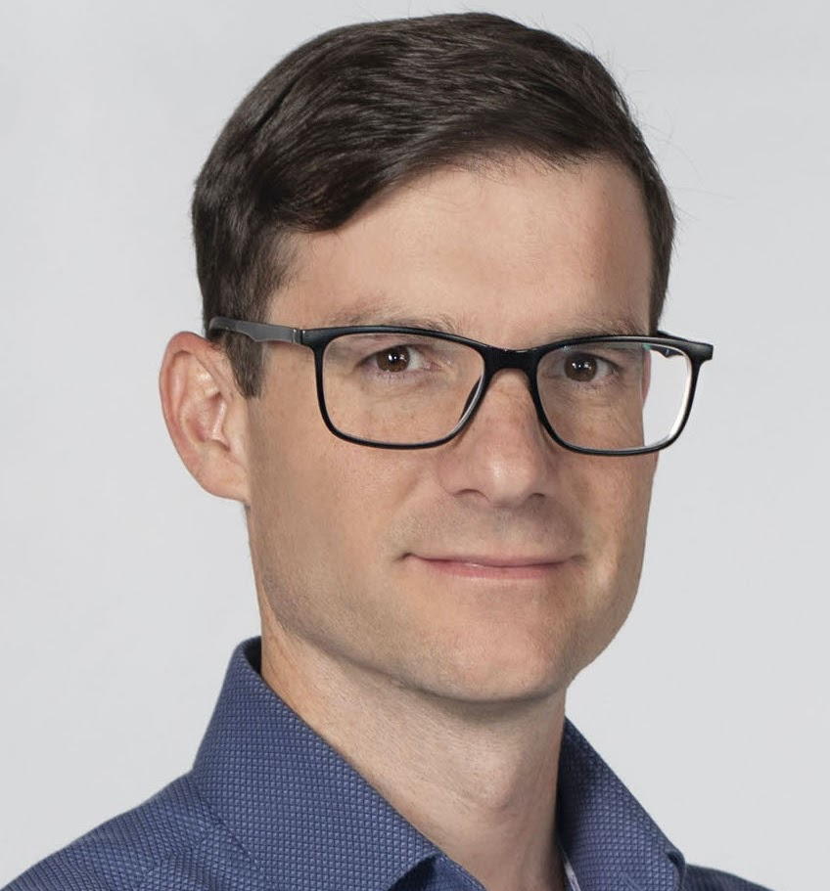


Organizers
Francisco Munoz-Martinez
Postdoc Researcher
University of Murcia
francisco.munoz2@um.es
Raveesh Garg
Ph.D Student
Georgia Institute of Technology
raveesh.g@gatech.edu
José L. Abellán
Ramón y Cajal Researcher
University of Murcia
jlabellan@um.es
Manuel E. Acacio
Full Professor
University of Murcia
meacacio@um.es
Tushar Krishna
Associate Professor, School of ECE
Georgia Institute of Technology
tushar@ece.gatech.edu
Adrián Fenollar Navarro
Master Student
University of Murcia
adrian.fenollarn@um.es
STONNE Tutorial @ASPLOS 2023

Slide 4
Outline
Docker Image, Installation and overview of STONNE.
Hands-on #1: Simulating a real DNN on Flexible DNN Accelerators.
Hands-on #2: Simulating a DNN Layer on Flexagon using SST-STONNE.
Research use cases.
Conclusions.
STONNE Tutorial @ASPLOS 2023

Slide 5
Outline
Docker Image, Installation and overview of STONNE.
Hands-on #1: Simulating a real DNN on Flexible DNN Accelerators.
Hands-on #2: Simulating a DNN Layer on Flexagon using SST-STONNE.
Research use cases.
Conclusions.
STONNE Tutorial @ASPLOS 2023

Slide 6
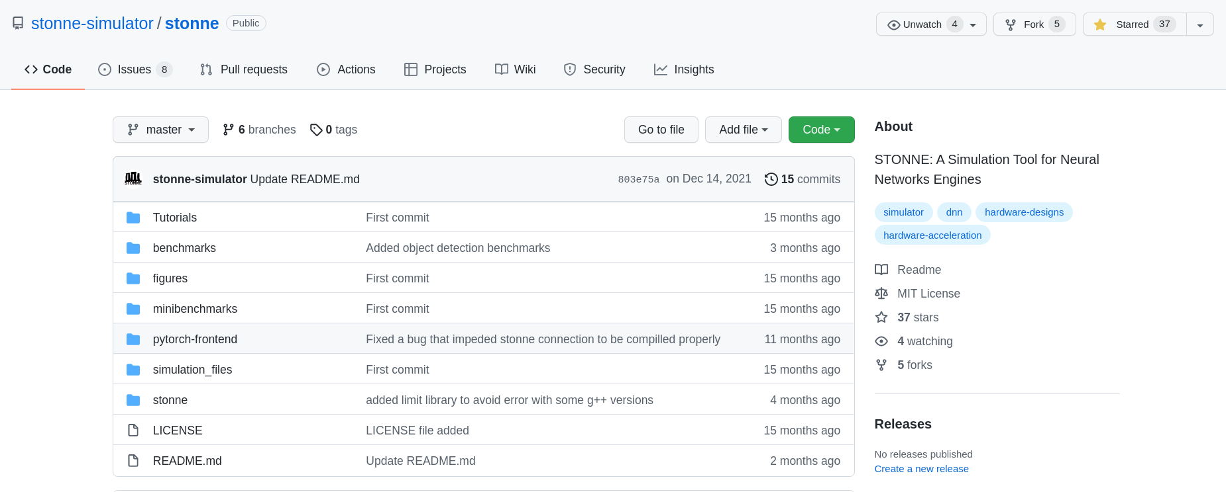
STONNE Repository
STONNE available under the MIT license on Github:
https://github.com/stonne-simulator/stonne
STONNE Tutorial @ASPLOS 2023

Slide 7
STONNE Requirements
STONNE dependencies:
Python 3.6 >= version< 3.9
C++ 14 or later.
Anaconda version 2021.05 or older.
.Linux OS (Tested on Ubuntu 18.05 and Manjaro 21.2.1).
Not tested in MAC OS.
STONNE Tutorial @ASPLOS 2023

Slide 8
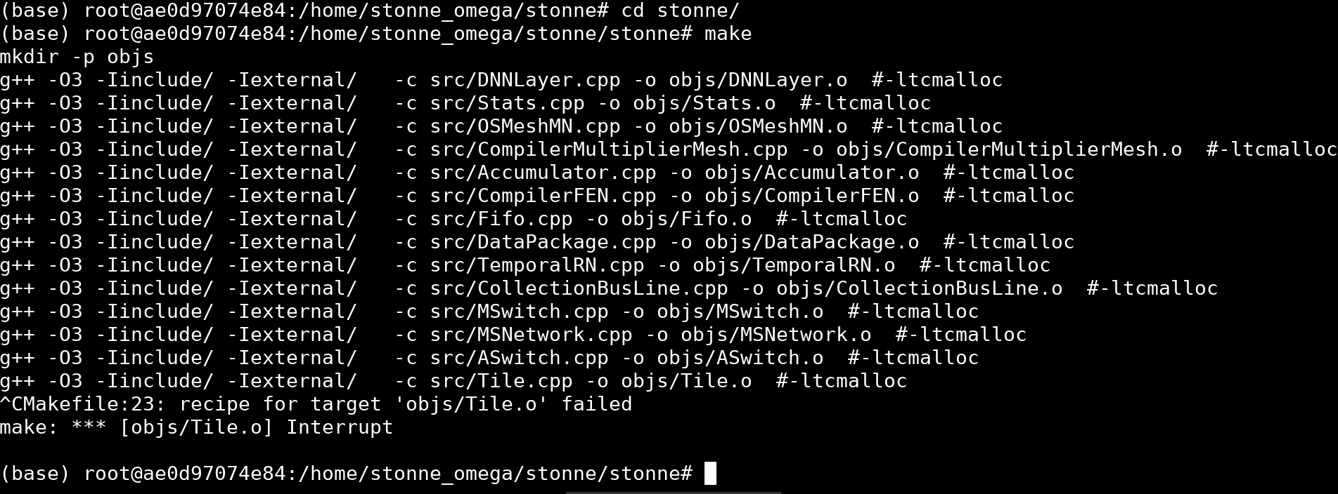
STONNE Installation
STONNE can be easily installed following a few steps:
STONNE User interface
STONNE Tutorial @ASPLOS 2023

Slide 9
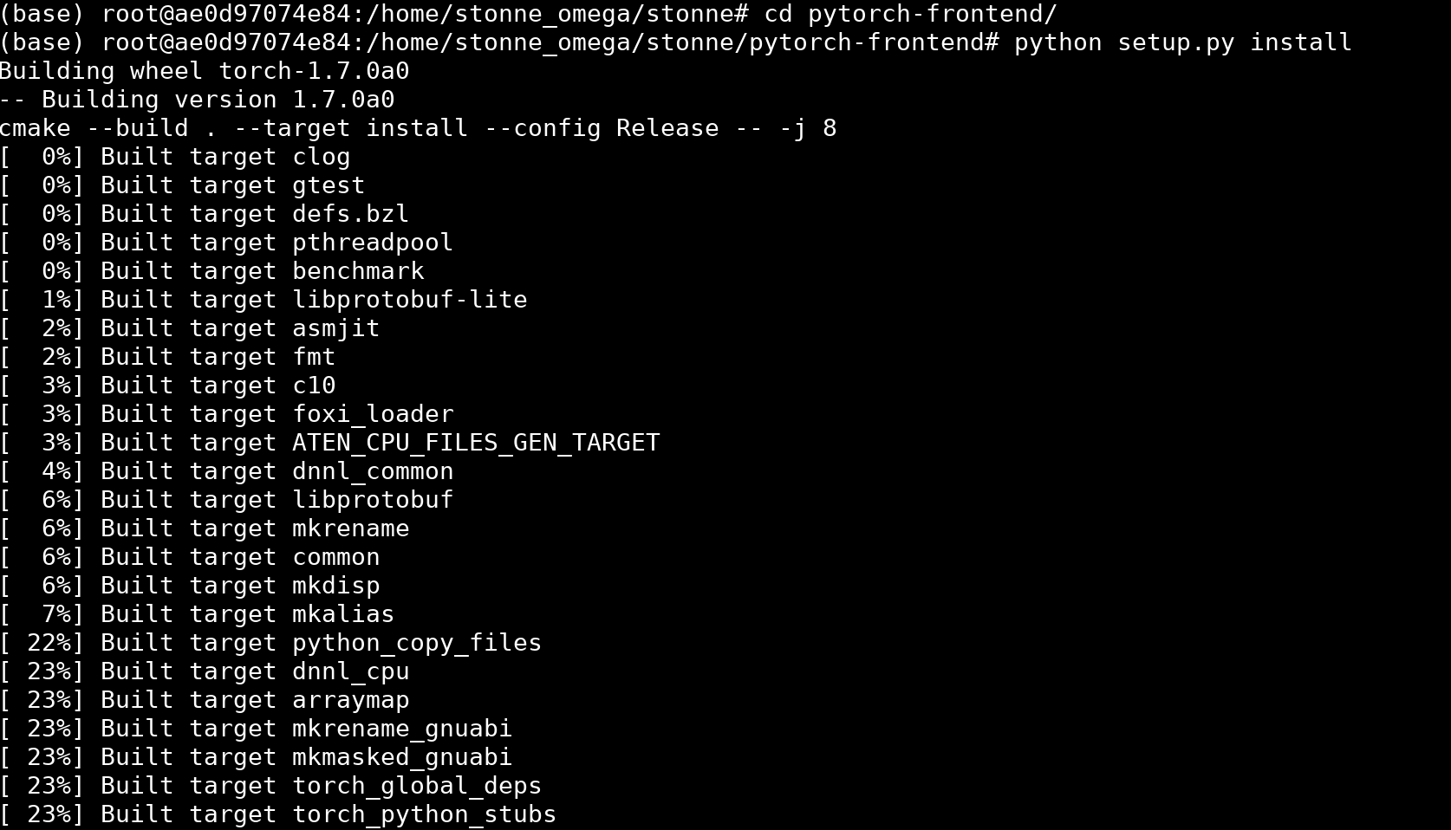
STONNE Installation
STONNE can be easily installed following a few steps:
Pytorch-Frontend
STONNE Tutorial @ASPLOS 2023

Slide 10
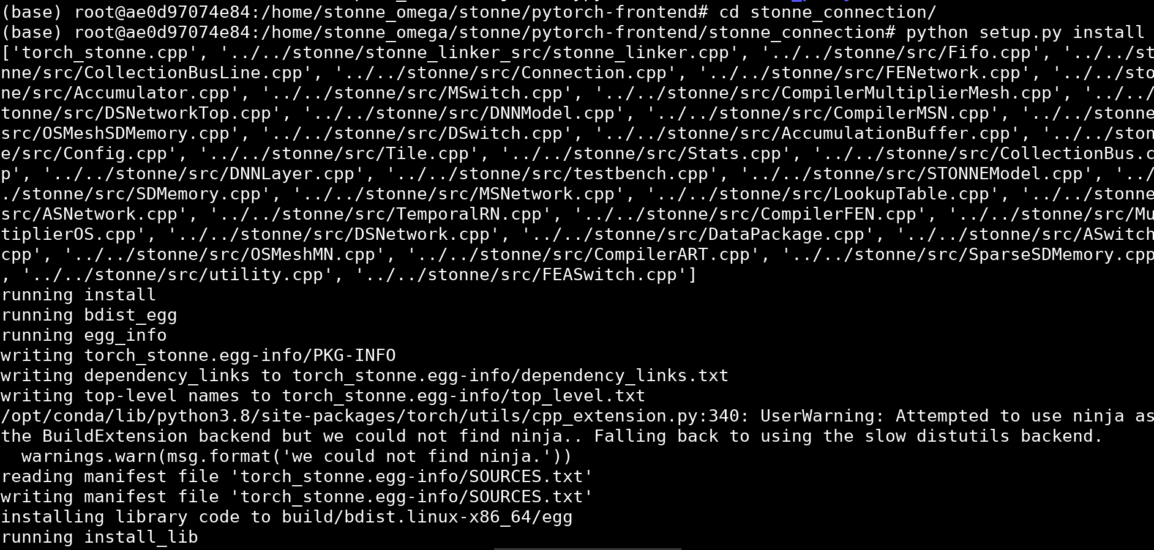
STONNE Installation
STONNE can be easily installed following a few steps:
Pytorch-stonne
STONNE Tutorial @ASPLOS 2023

Slide 11
Docker image
To avoid having to install the software, we have set up a docker image which can be directly downloaded and used:
sudo docker run -it stonnesimulator/stonne-simulators
git clone https://github.com/stonne-simulator/tutorials (inside docker)
STONNE Tutorial @ASPLOS 2023

Slide 12
Docker image
Project organization:
/STONNE:
stonne:
pytorch-frontend
stonne_connection
stonne:
stonne.elf
Include
src
external
stonne_linker_src
STONNE Tutorial @ASPLOS 2023

Slide 13
Docker image
Project organization:
/OMEGA:
omega
STONNE Tutorial @ASPLOS 2023

Slide 14
Docker image
Project organization:
/STONNE
stonne:
ASPLOS22
pytorch-frontend
stonne_connection
stonne:
stonne.elf
Include
src
external
stonne_linker_src
STONNE Tutorial @ASPLOS 2023

Slide 15
Docker image
Project organization:
/STONNE
stonne:
pytorch-frontend
stonne_connection
stonne:
stonne.elf
Include
src
external
stonne_linker_src
STONNE Tutorial @ASPLOS 2023

Slide 16
Docker image
Project organization:
/STONNE:
stonne:
pytorch-frontend
stonne_connection
stonne:
stonne.elf
Include
src
external
stonne_linker_src
STONNE Tutorial @ASPLOS 2023

Slide 17
Docker image
Project organization:
/STONNE:
omega
stonne:
pytorch-frontend
stonne_connection
stonne:
stonne.elf
Include
src
external
stonne_linker_src
STONNE Tutorial @ASPLOS 2023

Slide 18
Docker image
Project organization:
/STONNE:
stonne:
pytorch-frontend
stonne_connection
stonne:
stonne.elf
Include
src
external
stonne_linker_src
STONNE Tutorial @ASPLOS 2023

Slide 19
STONNE Source files
/STONNE/stonne/include: Contains the headers
AccumulationBuffer.h
Accumulator.h
ReductionNetwork.h
ASNetwork.h
ASwitch.h
CollectionBus.h
CollectionBusLine.h
DistributionNetwork.h
DSNetworkTop.h
DSNetwork.h
DSwitch.h
MultiplierNetwork.h
MSNetwork.h
MultiplierOS.h
MSwitch.h
MemoryController.h
SDMemory.h
SparseSDMemory.h
OSMeshSDMemory.h
Connection.h
DataPackage.h
Fifo.h
STONNEModel.h
STONNE Tutorial @ASPLOS 2023

Slide 20
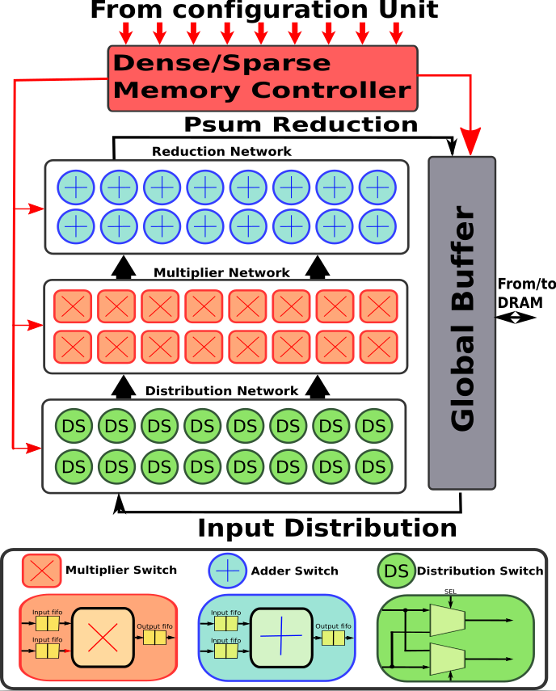
STONNE Source files
STONNE organization is able to abstract the main components of the architecture
STONNE Tutorial @ASPLOS 2023

Slide 21

STONNE Source files
Abstract classes allow to abtract the 4 main components.
AccumulationBuffer.h
Accumulator.h
ReductionNetwork.h
ASNetwork.h
ASwitch.h
CollectionBus.h
CollectionBusLine.h
DistributionNetwork.h
DSNetworkTop.h
DSNetwork.h
DSwitch.h
MultiplierNetwork.h
MSNetwork.h
MultiplierOS.h
MSwitch.h
MemoryController.h
SDMemory.h
SparseSDMemory.h
OSMeshSDMemory.h
Connection.h
DataPackage.h
Fifo.h
STONNEModel.h
STONNE Tutorial @ASPLOS 2023

Slide 22
STONNE Source files
The real hardware comonents implement the abstract classes.
AccumulationBuffer.h
Accumulator.h
ReductionNetwork.h
ASNetwork.h
ASwitch.h
CollectionBus.h
CollectionBusLine.h
DistributionNetwork.h
DSNetworkTop.h
DSNetwork.h
DSwitch.h
MultiplierNetwork.h
MSNetwork.h
MultiplierOS.h
MSwitch.h
MemoryController.h
SDMemory.h
SparseSDMemory.h
OSMeshSDMemory.h
Connection.h
DataPackage.h
Fifo.h
STONNEModel.h
Reduction Networks
Distribution Networks
Multiplier Networks
Memory Controllers
Other Useful components
STONNE Tutorial @ASPLOS 2023

Slide 23
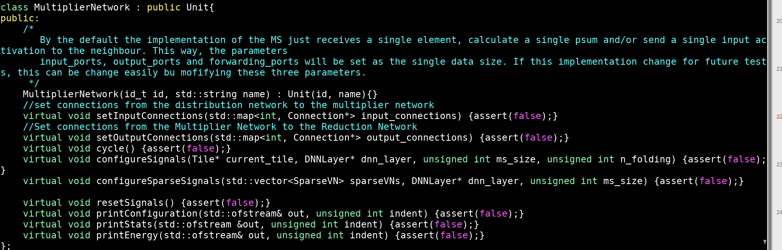
STONNE Source files
Every component implements its void cycle() method which defines the behaviour of the component.
STONNE Tutorial @ASPLOS 2023

Slide 24
STONNE Source files
/STONNE/stonne/src: Contains the main code
AccumulationBuffer.cpp
Accumulator.cpp
ASNetwork.cpp
ASwitch.cpp
CollectionBus.cpp
CollectionBusLine.cpp
DSNetworkTop.cpp
DSNetwork.cpp
DSwitch.cpp
MSNetwork.cpp
MultiplierOS.cpp
MSwitch.cpp
MemoryController.cpp
SDMemory.cpp
SparseSDMemory.cpp
OSMeshSDMemory.cpp
Connection.cpp
DataPackage.cpp
Fifo.cpp
STONNEModel.cpp
STONNE Tutorial @ASPLOS 2023

Slide 25
STONNE Source files
STONNEModel.cpp drives the simulation based on the user configuration file
AccumulationBuffer.cpp
Accumulator.cpp
ASNetwork.cpp
ASwitch.cpp
CollectionBus.cpp
CollectionBusLine.cpp
DSNetworkTop.cpp
DSNetwork.cpp
DSwitch.cpp
MSNetwork.cpp
MultiplierOS.cpp
MSwitch.cpp
MemoryController.cpp
SDMemory.cpp
SparseSDMemory.cpp
OSMeshSDMemory.cpp
Connection.cpp
DataPackage.cpp
Fifo.cpp
STONNEModel.cpp
STONNE Tutorial @ASPLOS 2023

Slide 26
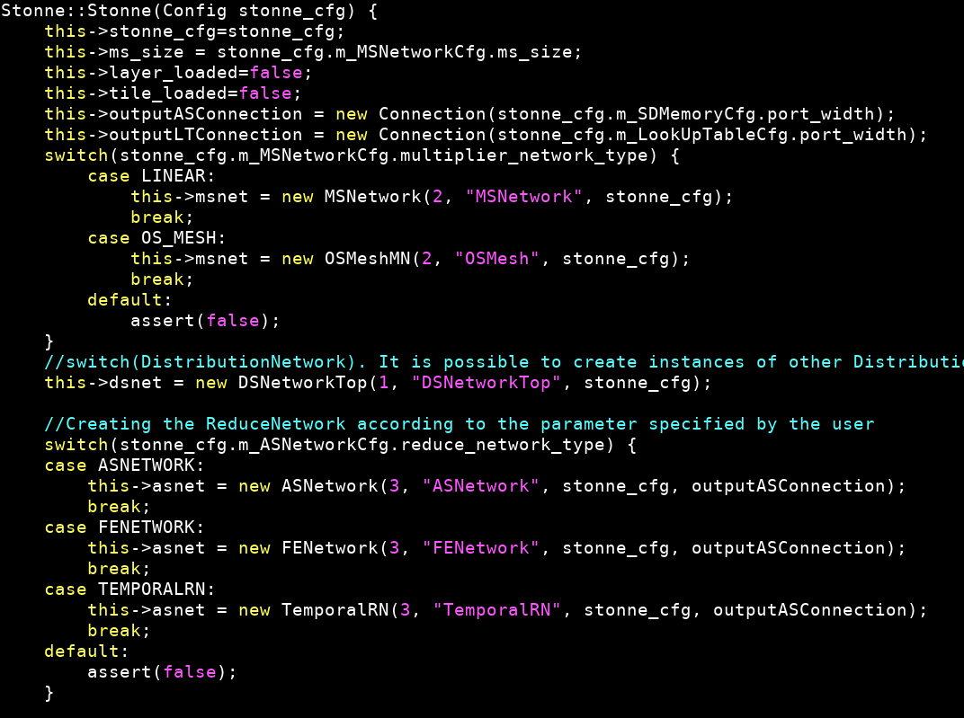
STONNE Source files
STONNEModel.cpp drives the simulation based on the user configuration file
1. The code reads the input file and selects the correct modules:
STONNE Tutorial @ASPLOS 2023

Slide 27
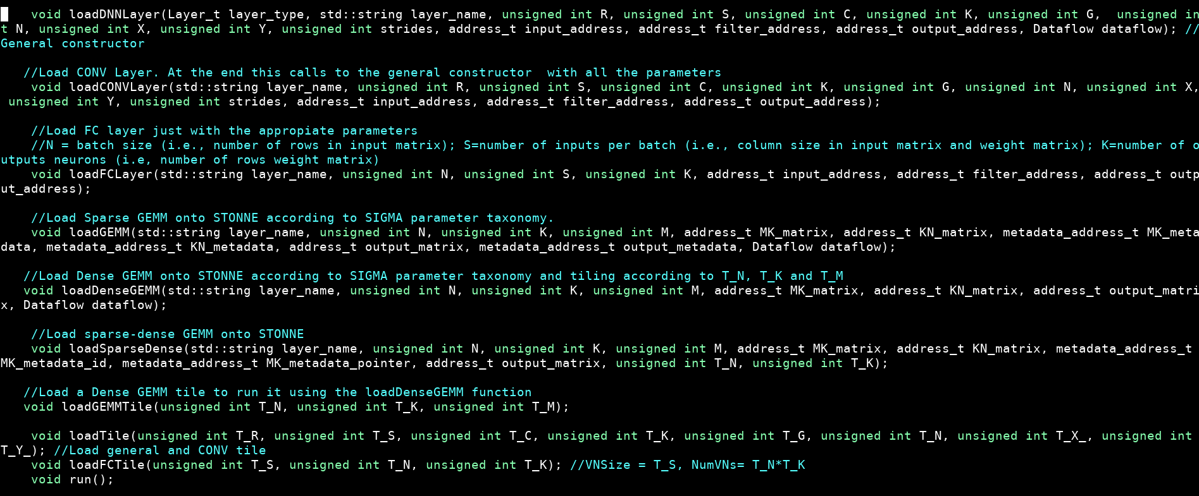
STONNE Source files
STONNEModel.cpp drives the simulation based on the user configuration file
2. After this, the class defines methods to load the layer, tile parameters, memory addresses and run the simulation. This is used to interface the simulator
STONNE Tutorial @ASPLOS 2023

Slide 28
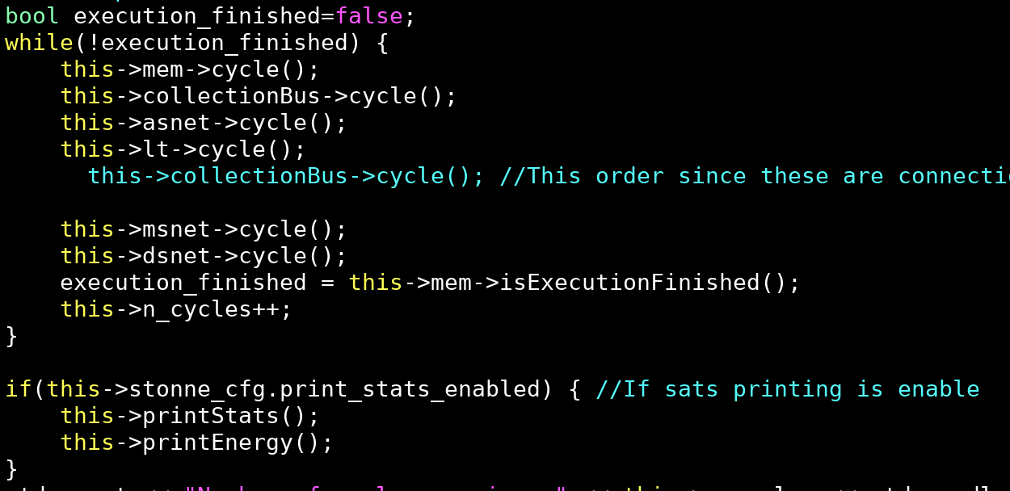
STONNE Source files
STONNEModel.cpp drives the simulation based on the user configuration file
3. The code runs the cycle() method of each component until the execution is completed.
STONNE Tutorial @ASPLOS 2023

Slide 29
Outline
Docker Image, Installation and overview of STONNE.
Hands-on #1: Simulating a real DNN on Flexible DNN Accelerators.
Hands-on #2: Simulating a DNN Layer on Flexagon using SST-STONNE.
Research use cases.
Conclusions.
STONNE Tutorial @ASPLOS 2023

Slide 30
Objectives
1. Comprehensively understand how do flexible DNN architectures work.
2. Understand how to run simulations in STONNE using its STONNE User interface.
Understand how to run a real DNN in STONNE using the framework Pytorch.
STONNE Tutorial @ASPLOS 2023

Slide 31
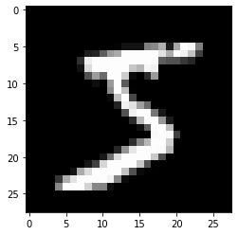
DNN benchmark
We will go through a real-life example to motivate our use case.
Application task: Image digit recognition
Benchmark: A Convolutional Neural Network (CNN).
Dataset: MNIST (60000 28x28-size images)
CNN
5
STONNE Tutorial @ASPLOS 2023

Slide 32
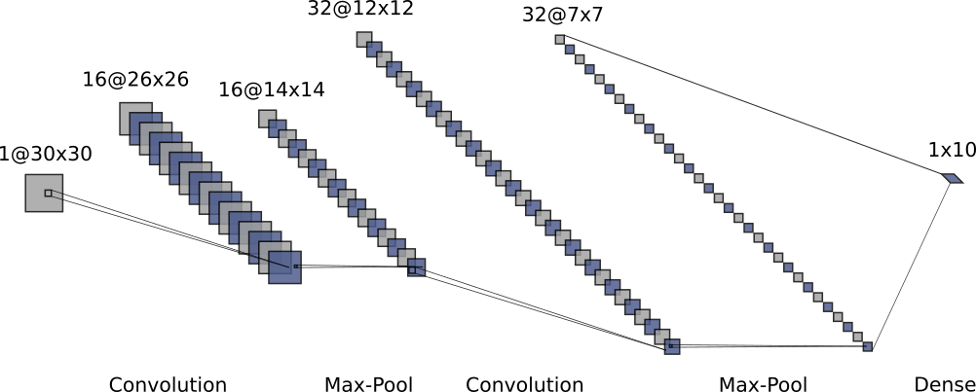
CNN model
Layer | Operation | R | S | C | K | G | N | X | Y
0 | CONV | 5 | 5 | 1 | 16 | 1 | 1 | 32 | 32
1 | MaxPool | 2 | 2 | 16 | 16 | 1 | 1 | 28 | 28
2 | CONV | 5 | 5 | 16 | 32 | 1 | 1 | 18 | 18
3 | MaxPool | 2 | 2 | 32 | 32 | 1 | 1 | 14 | 14
4 | Dense | - | - | 1568 | 10 | - | - | - | -
STONNE Tutorial @ASPLOS 2023

Slide 33
CNN model
Layer | Operation | R | S | C | K | G | N | X | Y
0 | CONV | 5 | 5 | 1 | 16 | 1 | 1 | 30 | 30
1 | MaxPool | 2 | 2 | 16 | 16 | 1 | 1 | 26 | 26
2 | CONV | 5 | 5 | 16 | 32 | 1 | 1 | 14 | 14
3 | MaxPool | 2 | 2 | 32 | 32 | 1 | 1 | 12 | 12
4 | Dense | - | - | 1568 | 10 | - | - | - | -
Simulated
Simulated
Simulated
STONNE Tutorial @ASPLOS 2023

Slide 34
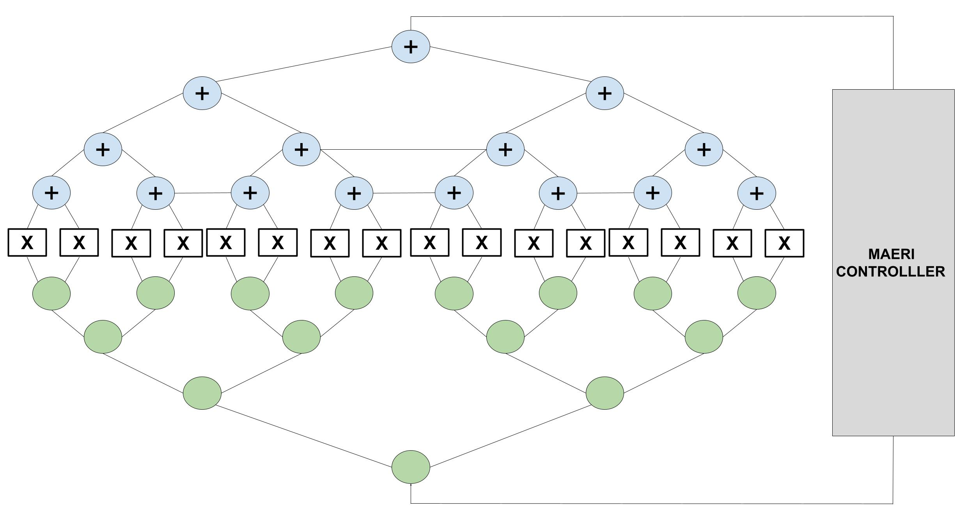
Simulated architecture
We will simulate our benchmark in a 64-MS MAERI architecture.
ID | Number of Multipliers | Distribution Bandwidth | Reduction Bandwidth
1 | 64 | 64 | 64
STONNE Tutorial @ASPLOS 2023

Slide 35
Mapping the CNN onto the architectures
Given our CNN and our architecture, how do we map the computation?
STONNE Tutorial @ASPLOS 2023

Slide 36
Mapping the CNN onto the architectures
Given our CNN and our two architectures, how do we map the computation?
Answer: Tiling the layer.
STONNE Tutorial @ASPLOS 2023

Slide 37
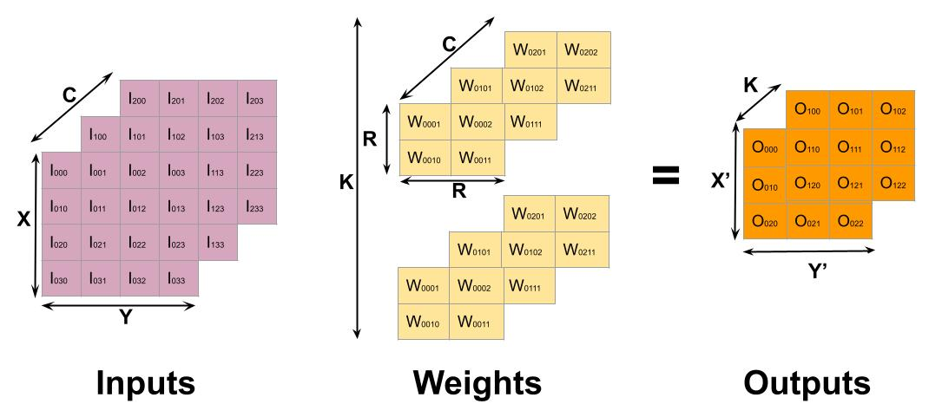
Mapping the CNN onto the architecture
Given our CNN and our two architectures, how do we map the computation?
Example: How do we map this layer?
Mapping?
R | S | C | K | G | N | X | Y | X' | Y'
2 | 2 | 3 | 2 | 1 | 1 | 4 | 4 | 3 | 3
T_R | T_S | T_C | T_K | T_G | T_N | T_X' | T_Y'
? | ? | ? | ? | ? | ? | ? | ?
STONNE Tutorial @ASPLOS 2023

Slide 38
Mapping the CNN onto the architecture
Given our CNN and our two architectures, how do we map the computation?
Example: How do we map this layer?
Mapping?
R | S | C | K | G | N | X | Y | X' | Y'
2 | 2 | 3 | 2 | 1 | 1 | 4 | 4 | 3 | 3
T_R | T_S | T_C | T_K | T_G | T_N | T_X' | T_Y'
2 | 2 | 3 | 1 | 1 | 1 | 1 | 1
Virtual Neuron Size: ?
Number of Virtual Neurons: ?
STONNE Tutorial @ASPLOS 2023

Slide 39
Mapping the CNN onto the architecture
Given our CNN and our two architectures, how do we map the computation?
Example: How do we map this layer?
Mapping?
R | S | C | K | G | N | X | Y | X' | Y'
2 | 2 | 3 | 2 | 1 | 1 | 4 | 4 | 3 | 3
T_R | T_S | T_C | T_K | T_G | T_N | T_X' | T_Y'
2 | 2 | 3 | 1 | 1 | 1 | 1 | 1
Virtual Neuron Size: 2*2*3=12
Number of Virtual Neurons: 1*1*1*1*1=1
STONNE Tutorial @ASPLOS 2023

Slide 40
Mapping the CNN onto the architecture
Given our CNN and our two architectures, how do we map the computation?
Example: How do we map this layer?
Mapping?
R | S | C | K | G | N | X | Y | X' | Y'
2 | 2 | 3 | 2 | 1 | 1 | 4 | 4 | 3 | 3
T_R | T_S | T_C | T_K | T_G | T_N | T_X' | T_Y'
? | ? | ? | ? | ? | ? | ? | ?
Virtual Neuron Size: ?
Number of Virtual Neurons: ?
STONNE Tutorial @ASPLOS 2023

Slide 41
Mapping the CNN onto the architecture
Given our CNN and our two architectures, how do we map the computation?
Example: How do we map this layer?
Mapping?
R | S | C | K | G | N | X | Y | X' | Y'
2 | 2 | 3 | 2 | 1 | 1 | 4 | 4 | 3 | 3
T_R | T_S | T_C | T_K | T_G | T_N | T_X' | T_Y'
2 | 2 | 1 | 2 | 1 | 1 | 1 | 1
Virtual Neuron Size: 2*2*1=4
Number of Virtual Neurons: 2*1*1*1*1=2
STONNE Tutorial @ASPLOS 2023

Slide 42
Mapping the CNN onto the architecture
Given our CNN and our two architectures, how do we map the computation?
Example: How do we map this layer?
Mapping?
R | S | C | K | G | N | X | Y | X' | Y'
2 | 2 | 3 | 2 | 1 | 1 | 4 | 4 | 3 | 3
T_R | T_S | T_C | T_K | T_G | T_N | T_X' | T_Y'
? | ? | ? | ? | ? | ? | ? | ?
Virtual Neuron Size: ?
Number of Virtual Neurons: ?
STONNE Tutorial @ASPLOS 2023

Slide 43
Mapping the CNN onto the architecture
Given our CNN and our two architectures, how do we map the computation?
Example: How do we map this layer?
Mapping?
R | S | C | K | G | N | X | Y | X' | Y'
2 | 2 | 3 | 2 | 1 | 1 | 4 | 4 | 3 | 3
T_R | T_S | T_C | T_K | T_G | T_N | T_X' | T_Y'
2 | 2 | 1 | 1 | 1 | 1 | 2 | 2
Virtual Neuron Size: 2*2*1=4
Number of Virtual Neurons: 1*1*1*2*2=4
STONNE Tutorial @ASPLOS 2023

Slide 44
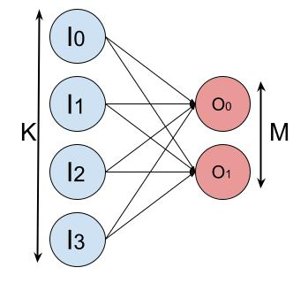
Mapping the CNN onto the architecture
Given our CNN and our two architectures, how do we map the computation?
Example: How do we map this layer?
Mapping?
K | M | N
4 | 2 | 1
T_K | T_M | T_N
? | ? | ?
Virtual Neuron Size: ?
Number of Virtual Neurons: ?
STONNE Tutorial @ASPLOS 2023

Slide 45
Mapping the CNN onto the architecture
Given our CNN and our two architectures, how do we map the computation?
Example: How do we map this layer?
S
K
Mapping?
S | K | N
4 | 2 | 1
T_S | T_K | T_N
4 | 2 | 1
Virtual Neuron Size: 4
Number of Virtual Neurons: 2*1=2
STONNE Tutorial @ASPLOS 2023

Slide 46
Mapping the CNN onto the architecture
Given our CNN and our architecture, how do we map the computation?
Layer | Operation | R | S | C | K | G | N | X | Y
0 | CONV | 5 | 5 | 1 | 16 | 1 | 1 | 32 | 32
1 | MaxPool | 2 | 2 | 16 | 16 | 1 | 1 | 28 | 28
2 | CONV | 5 | 5 | 16 | 32 | 1 | 1 | 18 | 18
3 | MaxPool | 2 | 2 | 32 | 32 | 1 | 1 | 14 | 14
Layer | Operation | S | K | N
4 | Dense | 1568 | 10 | 1 |  | - | - | - | -
Simulated
Number of Multipliers | DN BW | RN BW
64 | 64 | 64
Simulated
Simulated
STONNE Tutorial @ASPLOS 2023

Slide 47
Mapping the CNN onto the architecture
Layer | Operation | R | S | C | K | G | N | X | Y
0 | CONV | 5 | 5 | 1 | 16 | 1 | 1 | 32 | 32
1 | MaxPool | 2 | 2 | 16 | 16 | 1 | 1 | 28 | 28
2 | CONV | 5 | 5 | 16 | 32 | 1 | 1 | 18 | 18
3 | MaxPool | 2 | 2 | 32 | 32 | 1 | 1 | 14 | 14
Layer | Operation | K | M | N
4 | Dense | 1568 | 10 | 1 |  | - | - | - | -
Simulated
Number of Multipliers | DN BW | RN BW
64 | 64 | 64
Simulated
Simulated
Layer | Operation | T_R | T_S | T_C | T_K | T_G | T_N | T_X' | T_Y' | VN Size | # VNs | MSs used
0 | CONV | ? | ? | ? | ? | ? | ? | ? | ? | ? | ? | ?
2 | CONV | ? | ? | ? | ? | ? | ? | ? | ? | ? | ? | ?
Layer | Operation | T_S | T_K | T_N
4 | Dense | ? | ? | ? | ? | ? | ? | ? | ? | ? | ? | ?
STONNE Tutorial @ASPLOS 2023

Slide 48
Mapping the CNN onto the architecture
Layer | Operation | R | S | C | K | G | N | X | Y
0 | CONV | 5 | 5 | 1 | 16 | 1 | 1 | 32 | 32
1 | MaxPool | 2 | 2 | 16 | 16 | 1 | 1 | 28 | 28
2 | CONV | 5 | 5 | 16 | 32 | 1 | 1 | 18 | 18
3 | MaxPool | 2 | 2 | 32 | 32 | 1 | 1 | 14 | 14
Layer | Operation | K | M | N
4 | Dense | 1568 | 10 | 1 |  | - | - | - | -
Simulated
Number of Multipliers | DN BW | RN BW
64 | 64 | 64
Simulated
Simulated
Layer | Operation | T_R | T_S | T_C | T_K | T_G | T_N | T_X' | T_Y' | VN Size | # VNs | MSs used
0 | CONV | 5 | 5 | 1 | 2 | 1 | 1 | 1 | 1 | 25 | 2 | 50
2 | CONV | ? | ? | ? | ? | ? | ? | ? | ? | ? | ? | ?
Layer | Operation | T_S | T_K | T_N
4 | Dense | ? | ? | ? | ? | ? | ? | ? | ? | ? | ? | ?
STONNE Tutorial @ASPLOS 2023

Slide 49
Mapping the CNN onto the architecture
Layer | Operation | R | S | C | K | G | N | X | Y
0 | CONV | 5 | 5 | 1 | 16 | 1 | 1 | 32 | 32
1 | MaxPool | 2 | 2 | 16 | 16 | 1 | 1 | 28 | 28
2 | CONV | 5 | 5 | 16 | 32 | 1 | 1 | 18 | 18
3 | MaxPool | 2 | 2 | 32 | 32 | 1 | 1 | 14 | 14
Layer | Operation | K | M | N
4 | Dense | 1568 | 10 | 1 |  | - | - | - | -
Simulated
Number of Multipliers | DN BW | RN BW
64 | 64 | 64
Simulated
Simulated
Layer | Operation | T_R | T_S | T_C | T_K | T_G | T_N | T_X' | T_Y' | VN Size | # VNs | MSs used
0 | CONV | 5 | 5 | 1 | 2 | 1 | 1 | 1 | 1 | 25 | 2 | 50
2 | CONV | 1 | 1 | 16 | 4 | 1 | 1 | 1 | 1 | 16 | 4 | 64
Layer | Operation | T_S | T_K | T_N
4 | Dense | ? | ? | ? | ? | ? | ? | ? | ? | ? | ? | ?
STONNE Tutorial @ASPLOS 2023

Slide 50
Mapping the CNN onto the architecture
Layer | Operation | R | S | C | K | G | N | X | Y
0 | CONV | 5 | 5 | 1 | 16 | 1 | 1 | 32 | 32
1 | MaxPool | 2 | 2 | 16 | 16 | 1 | 1 | 28 | 28
2 | CONV | 5 | 5 | 16 | 32 | 1 | 1 | 18 | 18
3 | MaxPool | 2 | 2 | 32 | 32 | 1 | 1 | 14 | 14
Layer | Operation | K | M | N
4 | Dense | 1568 | 10 | 1 |  | - | - | - | -
Simulated
Number of Multipliers | DN BW | RN BW
64 | 64 | 64
Simulated
Simulated
Layer | Operation | T_R | T_S | T_C | T_K | T_G | T_N | T_X' | T_Y' | VN Size | # VNs | MSs used
0 | CONV | 5 | 5 | 1 | 2 | 1 | 1 | 1 | 1 | 25 | 2 | 50
2 | CONV | 1 | 1 | 16 | 4 | 1 | 1 | 1 | 1 | 16 | 4 | 64
Layer | Operation | T_S | T_K | T_N
4 | Dense | 32 | 2 | 1 | - | - | - | - | - | 32 | 2 | 64
STONNE Tutorial @ASPLOS 2023

Slide 51
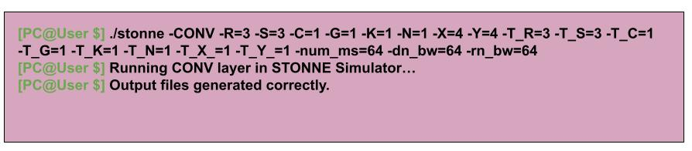
Simulating using the STONNE User interface
Before running the real benchmark we will use the STONNE User interface to simulate our layers.
This will run the layers with the correct dimensions but using random data.
STONNE Tutorial @ASPLOS 2023

Slide 52
Simulating using the STONNE User interface
Once the simulation has finished we can get the energy and area numbers:
Statistics.json
Energy
Table-Based Model
Energy
Statistics.counters
Area
Table-Based Model
Statistics.counters
Chip Area
STONNE Tutorial @ASPLOS 2023

Slide 53
Simulating using the STONNE User interface
Script to calculate the energy and area numbers:
/home/stonne_omega:
omega
stonne:
ASPLOS22
pytorch-frontend
stonne_connection
stonne:
stonne.elf
Include
src
external
stonne_linker_src
energy_tables
calculate_energy.py
energy_model.txt
STONNE Tutorial @ASPLOS 2023

Slide 54
Simulating using the STONNE User interface
Syntax: ./calculate_energy [-v] -table_file=<Energy&Area table> -counter_file=<counter stats> -out_file=<output file name>
STONNE Tutorial @ASPLOS 2023

Slide 55
Simulating using the Pytorch interface
Our image digit recognition benchmark is located in /home/stonne_omega/stonne/ASPLOS22/handson-1
train_dnn.py: Used to train our CNN and get the trained weights.
evaluate_dnn.py: Used to evaluate the accuracy of our CNN.
dnn.py: Defines our CNN.
deployment.py: This is the final file which is used to predict real images.
STONNE Tutorial @ASPLOS 2023

Slide 56
Simulating using the Pytorch interface
Steps towards CPU execution:
1. Run train_dnn.py script to obtain the weights.
2. Run evaluate_dnn.py to measure the accuracy of the network.
3. Run deployment.py
STONNE Tutorial @ASPLOS 2023

Slide 57
Simulating using the Pytorch interface
Steps towards CPU execution:
1. Run train_dnn.py script to obtain the weights.
2. Run evaluate_dnn.py to measure the accuracy of the network.
3. Run deployment.py
STONNE Tutorial @ASPLOS 2023

Slide 58
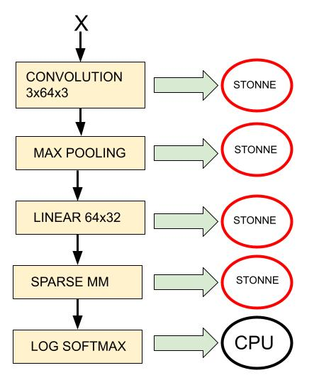
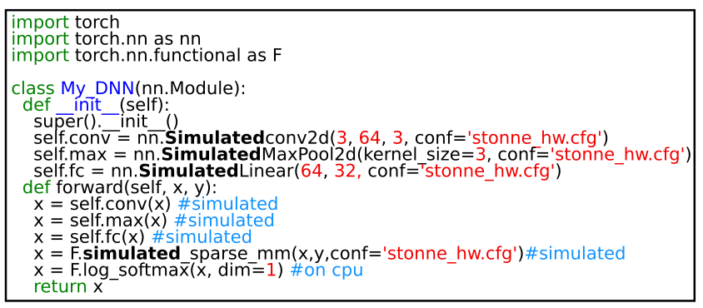
Simulating using the Pytorch interface
Once we have tested the inference procedure on the CPU, let's run it in our simulated accelerator.
Steps towards simulation:
1. Set up the hardware configuration file.
2. Set up the tile configuration files
3. Change the CONV and Linear operations in order to simulate them.
STONNE Tutorial @ASPLOS 2023

Slide 59
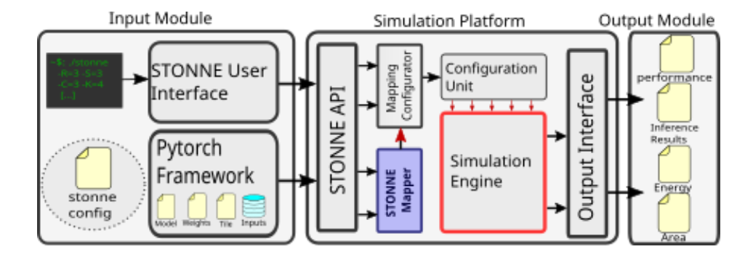
STONNE Mapper
New version of STONNE also includes a mapper to autogenerate the best tile.
Developer of STONNE mapper: Adrián fenollar navarro from the University of Murcia (Contact: adrian.fenollarn@um.es)
STONNE Tutorial @ASPLOS 2023

Slide 60
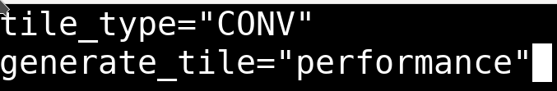
STONNE Mapper
STONNE Mapper usage:
From Pytorch:
From STONNE User Interface:
BEFORE (still compatible): ./stonne -CONV -R=3 -S=3 -C=6 -G=1 -K=6 -N=1 -X=20 -Y=20 -T_R=3 -T_S=3 -T_C=1 -T_G=1 -T_K=1 -T_N=1 -T_X_=3 -T_Y_=1 -num_ms=64 -dn_bw=8
Today: ./stonne -CONV -R=3 -S=3 -C=6 -G=1 -K=6 -N=1 -X=20 -Y=20 -generate_tile=energy -num_ms=64 -dn_bw=8 -rn_bw=8 -accumulation_buffer=1
Tile_file.txt
STONNE Tutorial @ASPLOS 2023

Slide 61
Agenda
Time (PT) | Topic | Presenter
1:40 – 2:00 | Flexible Accelerators | José L. Abellán
2:00 – 2:20 | Cycle accurate simulation and Overview of STONNE | José L. Abellán
2:20 – 3:20 | (Hands-on) STONNE | Francisco Muñoz-Martínez
3:20 – 3:40 | Coffee Break
3:40 – 4:10 | (Hands-on) SST-STONNE | Francisco Muñoz-Martínez
4:10 – 4:40 | (Hands-on) OMEGA | Raveesh Garg
4:40 – 5:00 | Roadmap and Concluding Remarks | Tushar Krishna
https://stonne-simulator.github.io/ASPLOSTUT.html

Slide 62
Outline
Docker Image, Installation and overview of STONNE.
Hands-on #1: Simulating a real DNN on Flexible DNN Accelerators.
Hands-on #2: Simulating a DNN Layer on Flexagon using SST-STONNE.
Research use cases.
Conclusions.
STONNE Tutorial @ASPLOS 2023

Slide 63
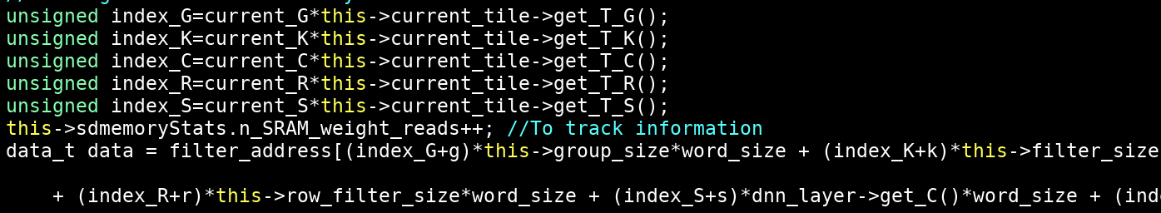
SST-STONNE
STONNE simulator does not model a proper memory hierarchy (only datapath).
See stonne/src/SDMemory.cpp
See stonne/src/SparseSDMemory.cpp
STONNE Tutorial @ASPLOS 2023

Slide 64
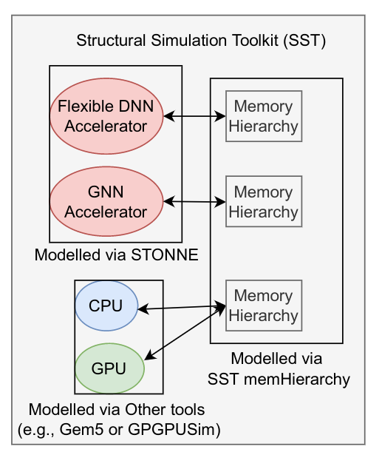
SST-STONNE
To improve this, we have integrated STONNE into SST simulator, creating SST-STONNE
https://github.com/stonne-simulator/sst-elements-with-stonne
STONNE Tutorial @ASPLOS 2023

Slide 65
Docker image
Project organization:
/SST-STONNE:
src:
sst-core
...
Sst-elements-with-stonne:
src/sst/elements/sstStonne
stonne_linker_src
src
Tests
Makefile
STONNE Tutorial @ASPLOS 2023

Slide 66
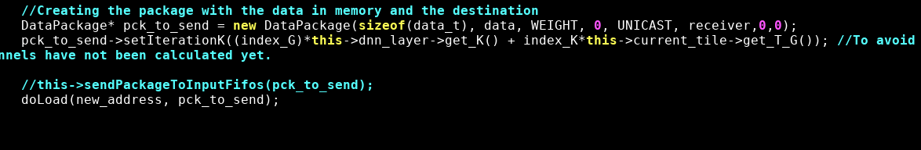
SST-STONNE
In this implementation the memory controllers send packets to memHierarchy simulator within SST.
See /SST-STONNE/src/sst-elements-with-stonne/src/sst/elements/sstStonne/src/SDMemory.cpp (inner
STONNE Tutorial @ASPLOS 2023

Slide 67
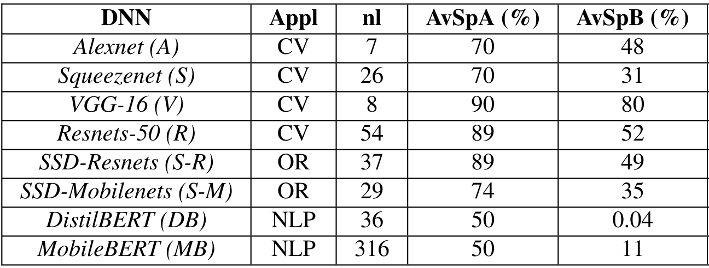
SpMSpM operation
Sparsity in matrices is an emerging trend in modern DNN workloads.
STONNE Tutorial @ASPLOS 2023

Slide 68
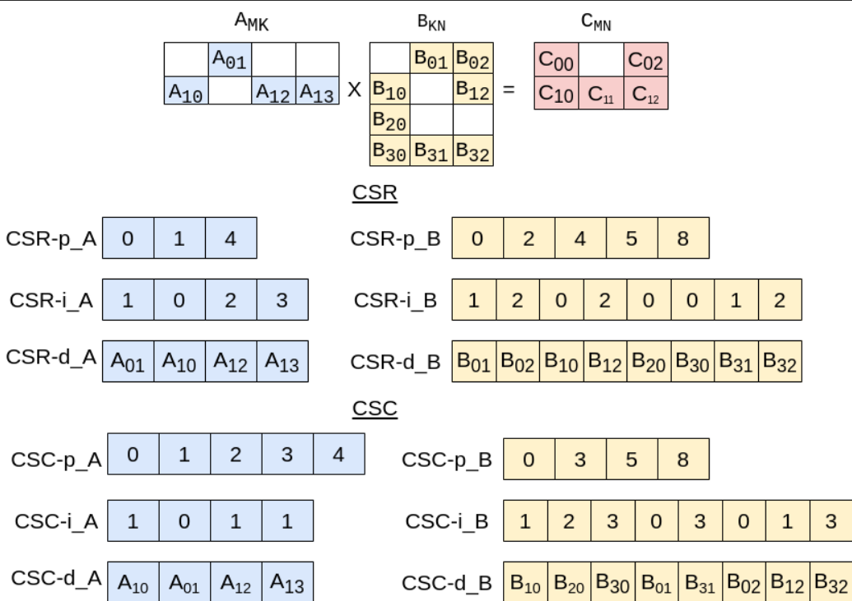
SpMSpM operation
Exploiting sparsity is done via the SpMSpM operation (Sparse-Sparse Matrix Multiplication).
STONNE Tutorial @ASPLOS 2023

Slide 69
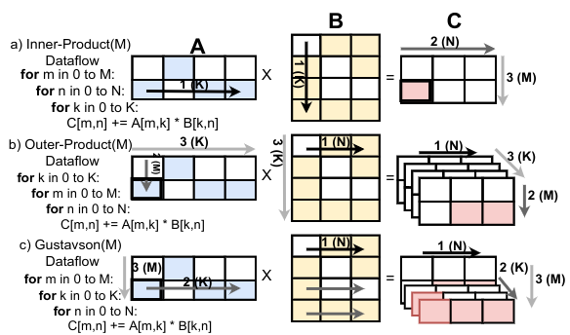
SpMSpM operation dataflows
The SpMSpM operation may be executed using three dataflows:
STONNE Tutorial @ASPLOS 2023

Slide 70
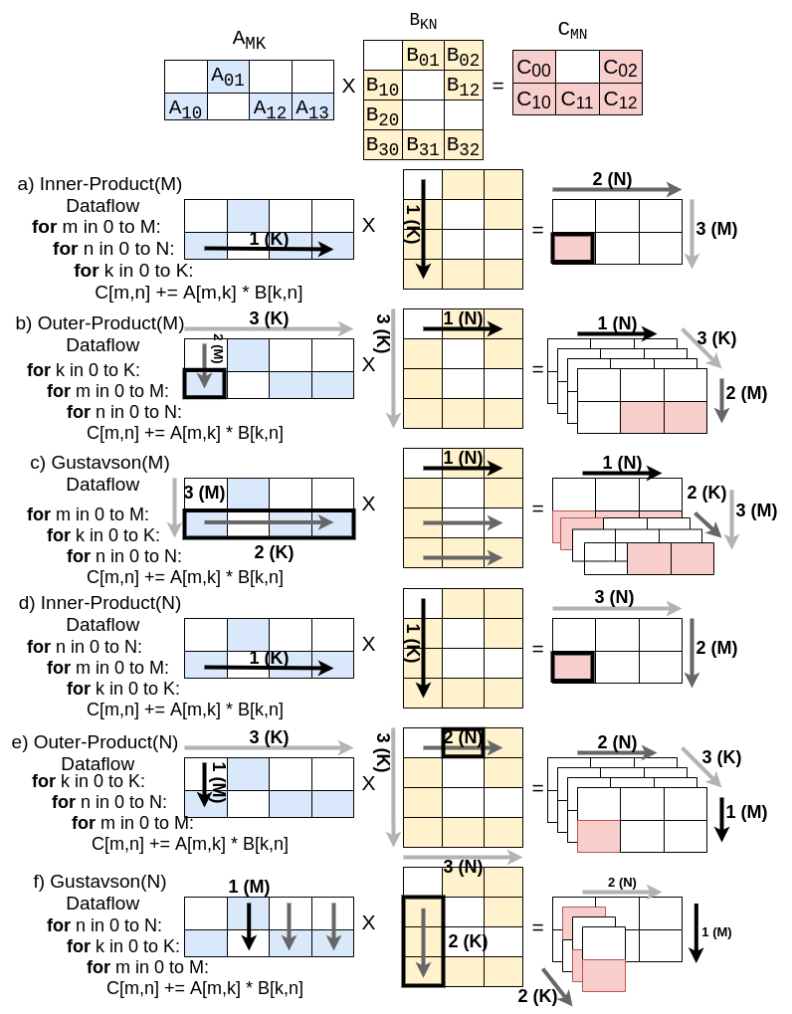
SpMSpM operation dataflows
The SpMSpM operation may be executed using three dataflows (6 variants):
STONNE Tutorial @ASPLOS 2023

Slide 71
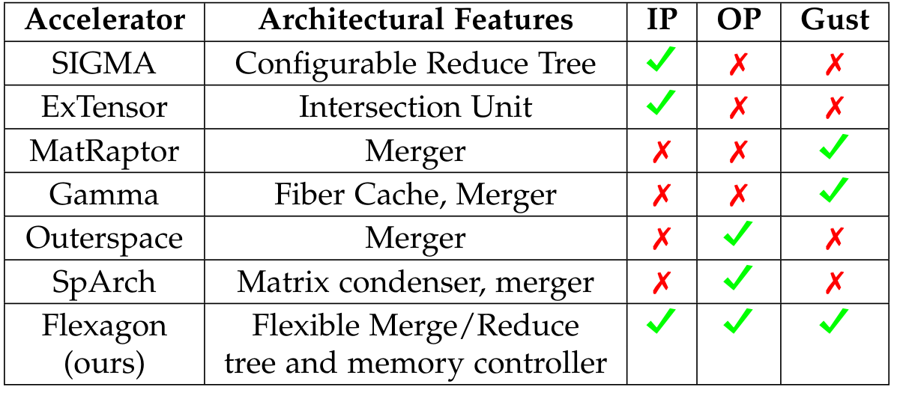
SpMSpM accelerators
SpMSpM state-of-the-art accelerators implements one dataflow.
STONNE Tutorial @ASPLOS 2023

Slide 72
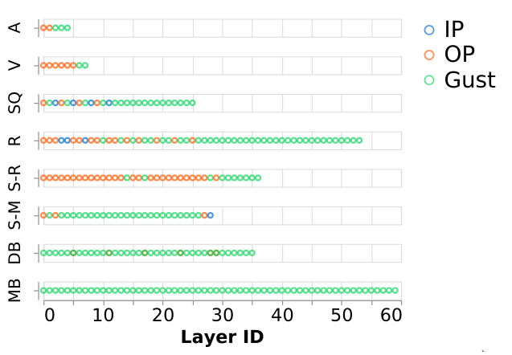
SpMSpM accelerators
However, the optimal dataflow changes from a DNN to another, and even within a DNN model, from one layer to another.
STONNE Tutorial @ASPLOS 2023

Slide 73
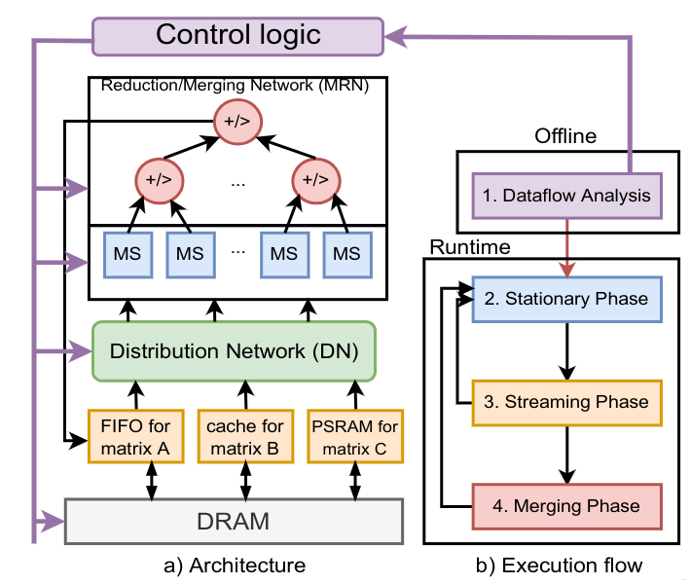
Flexagon
To fill this gap, we have proposed Flexagon, the first accelerator supporting the three dataflows.
Flexagon will be presented on ASPLOS 2023 on Tuesday at session 4C.
STONNE Tutorial @ASPLOS 2023

Slide 74
Flexagon
Flexagon is implemented in SST-STONNE by implementing three memory controllers and a new reduction/merging (MRN) network.
Reference for Inner-Product in SparseSDMemory.cpp
Reference for Outer-Product in OuterLoopSpGEMMSDMemory.cpp
Reference for Gustavson's in GustavsonsSpGEMMSDMemory.cpp
Reference for MRN: SparseFlex_ASNetwork.cpp
STONNE Tutorial @ASPLOS 2023

Slide 75
Flexagon
Let's run Flexagon!
STONNE Tutorial @ASPLOS 2023

Slide 76
Outline
Docker Image, Installation and overview of STONNE.
Hands-on #1: Simulating a real DNN on Flexible DNN Accelerators.
Hands-on #2: Using STONNE to evaluate a research use case – Exploiting sparsity.
Hands-on #3: Simulating a DNN Layer on Flexagon using SST-STONNE.
Research use cases.
Conclusions.
STONNE Tutorial @ASPLOS 2023

Slide 77
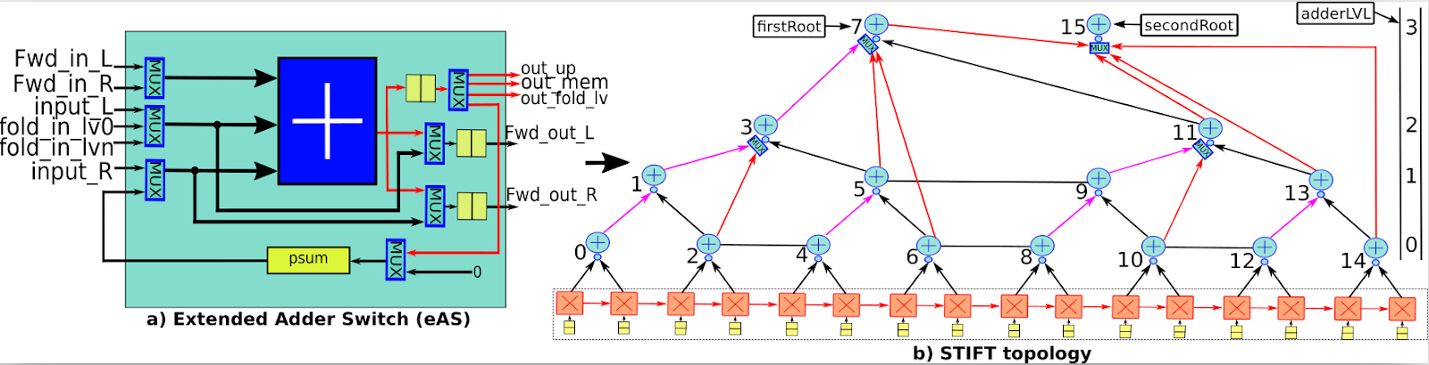
Use case #1: STIFT
We can use STONNE to create and evaluate new architectural modules for ML accelerators.
STIFT [Francisco Munoz-Martinez et. al., NOCS21]
STONNE Tutorial @ASPLOS 2023

Slide 78
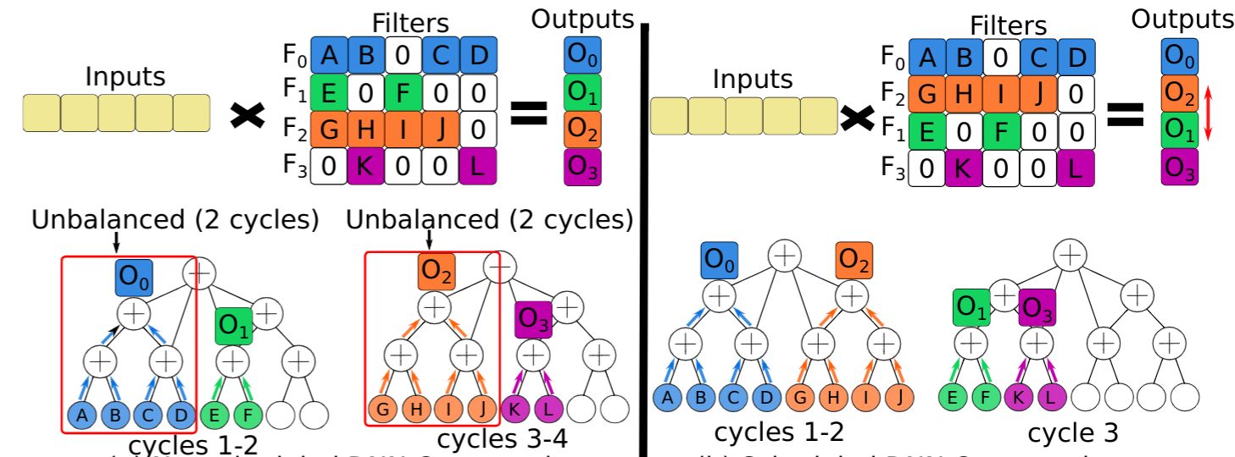
Use case #2: Sparse filters scheduling
We can use STONNE to evaluate new compilation techniques such as sparse scheduling.
STONNE [Francisco Munoz-Martinez et. al., IISWC21]
STONNE Tutorial @ASPLOS 2023

Slide 79
Outline
Docker Image, Installation and overview of STONNE.
Hands-on #1: Simulating a real DNN on Flexible DNN Accelerators.
Hands-on #2: Using STONNE to evaluate a research use case – Exploiting sparsity.
Hands-on #3: Simulating a DNN Layer on Flexagon using SST-STONNE.
Research use cases.
Conclusions.
STONNE Tutorial @ASPLOS 2023

Slide 80
Conclusions
STONNE is a cycle-accurate simulator for ML accelerators.
During this hands-on we have seen:
How to use the STONNE user interface to run synthetic operations.
How to use the Pytorch interface to run end-to-end models with STONNE.
How to use SST-STONNE to run Flexagon accelerator (attend our session 5C!!)
Find STONNE on http://github.com/stonne_simulator/stonne
Find SST-STONNE on https://github.com/stonne-simulator/sst-elements-with-stonne
STONNE Tutorial @ASPLOS 2023

Slide 81



Acknowledgements
Co-Design Center for Artificial Intelligence-Focused Architectures and Algorithms Funded By

Slide 82


Hands-on
Francisco Muñoz-Martínez
francisco.munoz2@um.es
Universidad de Murcia (UM)

